Slide 1
Laravel
Resource controllers
PHP WebDevelopment 2019
Милена Томова
Vratsa Software
https://vratsasoftware.com/

Slide 2
Checklist
Create resource controller /and Model/
Define resource routes
Define resource methods
Create views to manage a resource
Method spoofing for not HTML supported actions

Slide 3
Task 1
Make CRUD for the School`s halls.

Slide 4
Resource controllers

Slide 5
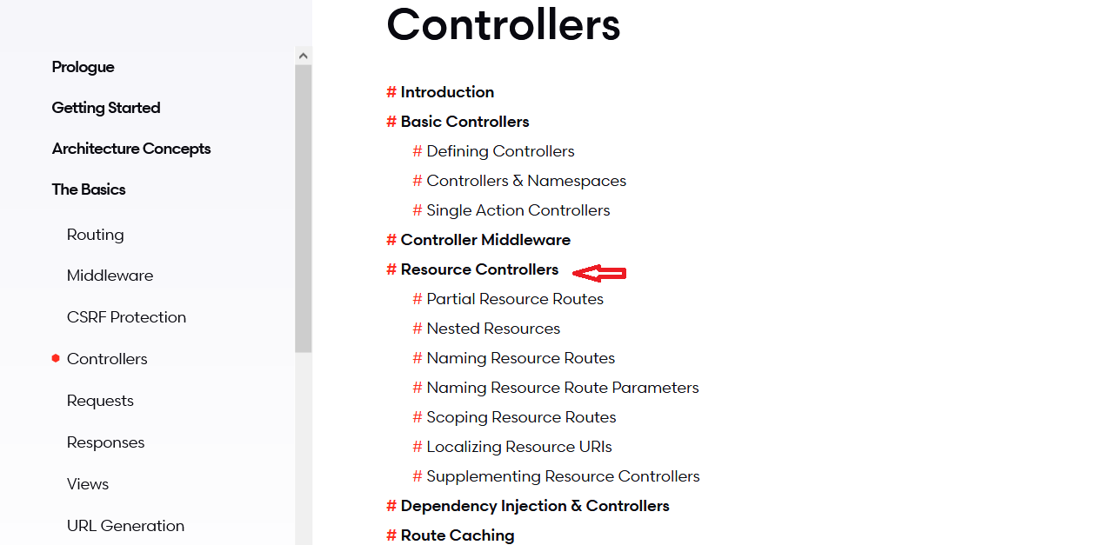
Resource Controllers
Start from here

Slide 6
CRUD

Slide 7
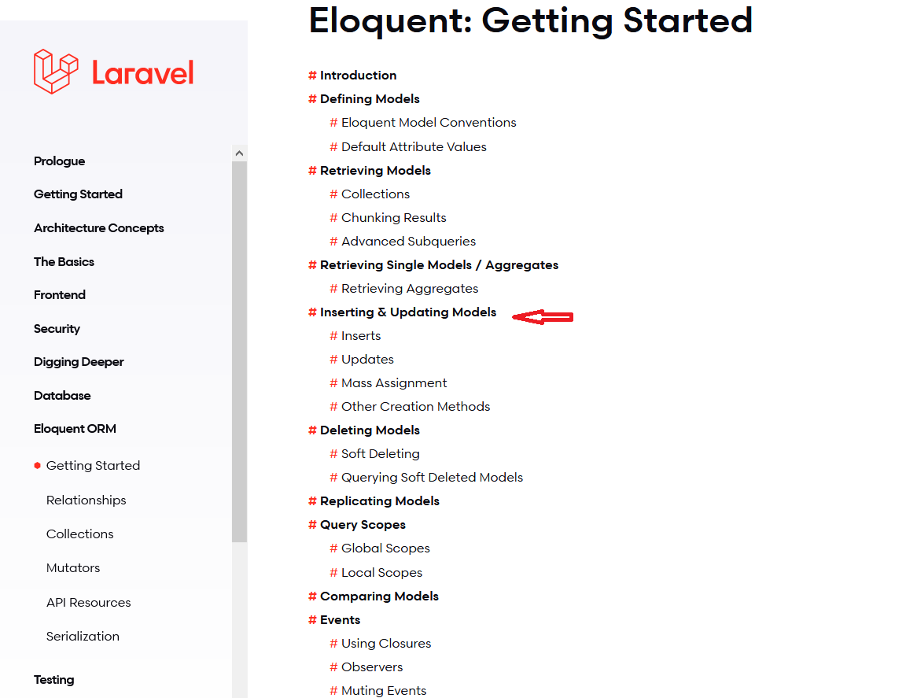
CRUD
Start from here

Slide 10



Trainings @ Vratsa Software
Vratsa Software – High-Quality Education, Profession and Jobs
www.vratsasoftware.com
The Nest Coworking
www.nest.bg
Vratsa Software @ Facebook
www.fb.com/VratsaSoftware
Slack Channel
www.vso.slack.com

